Slide 1
Edward Weston
Created and presented by Alliyah Brown

Slide 2
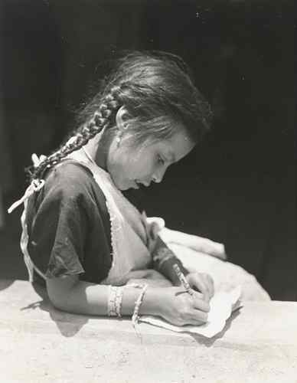
Early life/Inspiration
Edward Weston was born on March 24, 1886 in Highland Park, Illinois
When he was 16, Edwards father gave him a Bulls Eye #2 Kodak camera - this is what started his interest in photography
-would practice taking pictures at his
Aunt's Farm and the nearby park
Weston ended up self teaching himself how to capture photos by creating postcards and portraits
1908- Weston entered the Illinois College of Photography in Chicago

Slide 3
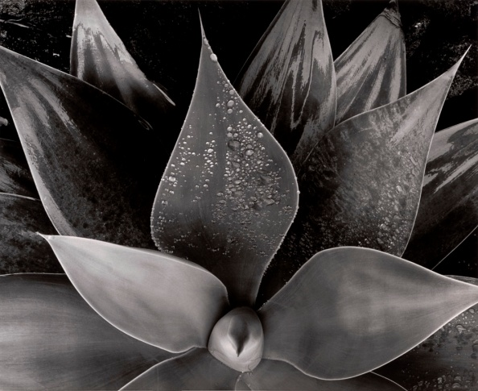
Starting his Career
Afterwards, he moved to the state of California and opened up a photography studio in Los Angeles in 1911.
-He, at first, made business by capturing film stars and ballerinas using a pictorial style that consist of using soft –focus lenses.
Photography was essentially Edwards only job

Slide 4
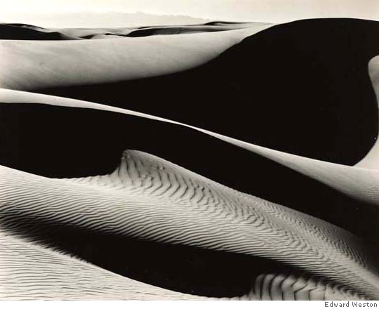
His Style
His photos had an identity of ripples, rounded edges which brought out their forms and textures.
His use of light is evident in his abstracted images of sea shells, wrinkled cabbage leaves, and waxy peppers, and, well, his portraits of woman.
At his studio, Edward began to develop and practice many different photography techniques that would affect his career in the furure.
-he became a master printer
-switched from the romantic style of pictorism to a new form of photography known as “straight”photography.

Slide 5
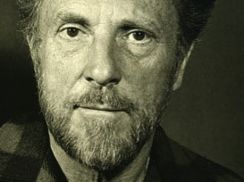
“Group f/64”
Edward cofounded this group along with photographer Ansel Adams in 1932
Group developed and practiced Straight Photography
-A.K.A pure photography
- to photography that attempts to depict a scene as realistically, and natural as possible
Members of this group would use large-format negatives and small lens apertures to produce the highest quality depth of field and a superior level of sharpness.

Slide 6
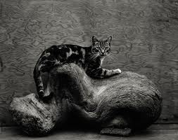
His Credo
Edwards goal was to capture all of natures natural shapes and forms
-Weston ambition was to celebrate the variety, yet highly related shapes and forms of nature.
He believed that nature had an unsurpassable beauty that should not be altered.

Slide 7
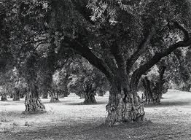
Best known for.............
His portrayal of nature
His landscape photos and studies of natural form, which have an unsurpassed beauty to them.
Around 1937, photographers, such as the world renown Dorothea Lange(who also was a friend of Weston), were documenting the effects of the Great Depression.
It was then that Weston became the first photographer to be awarded with the Guggenheim Foundation.

Slide 8
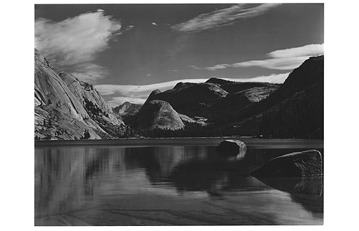
His End
In 1946, when Weston was about 60 years of age, he began experiencing symptoms of Parkinson’s disease.
That same year, the Museum of Modern Art featured and presented 300 prints of Weston’s life works in his honour.
Edward Weston finally died at his home in wildcat Hill in Carmel California on January 1, 1958, some 10 years after he stopped photography career.
His ashes were scattered into the pacific ocean at Pebbly Beach in Point Lobos, California.

Slide 9
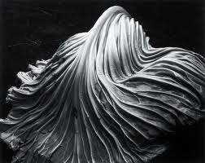
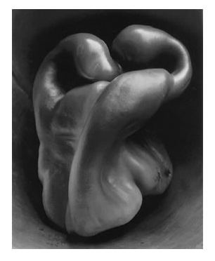
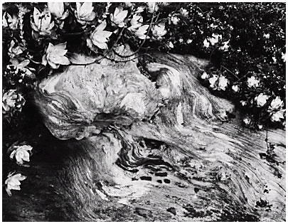
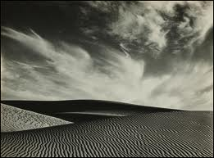
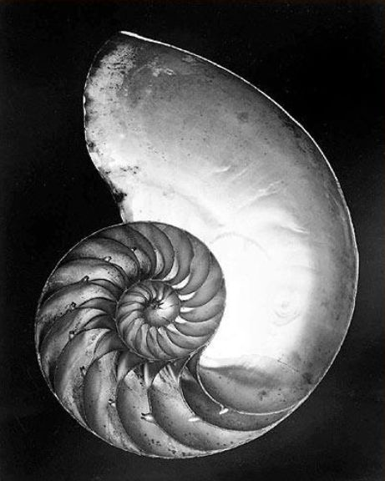
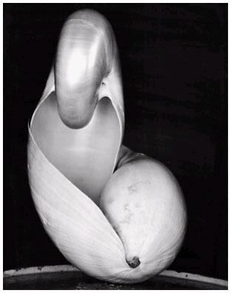
Some of his works
This is a cabbage leaf.
A pepper
Plant roots(I think)
Sea shells
Landscape- desert

Slide 10
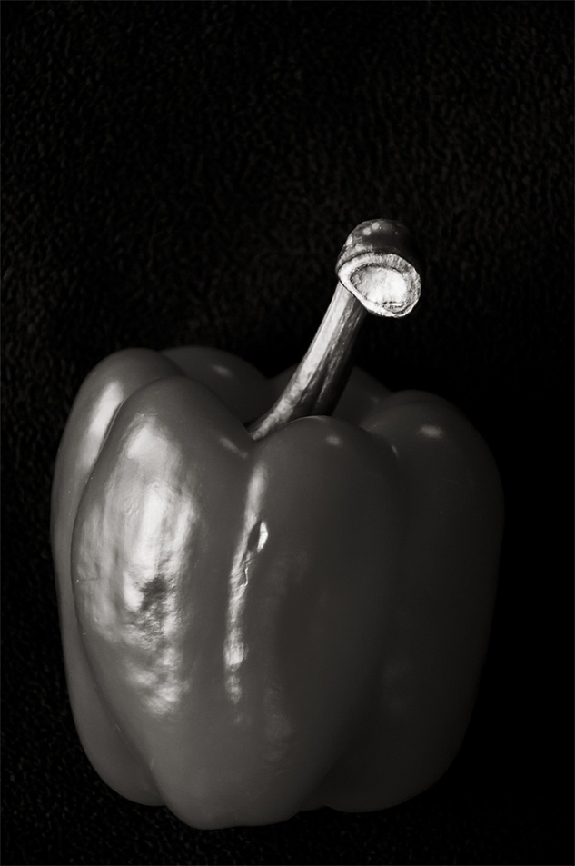
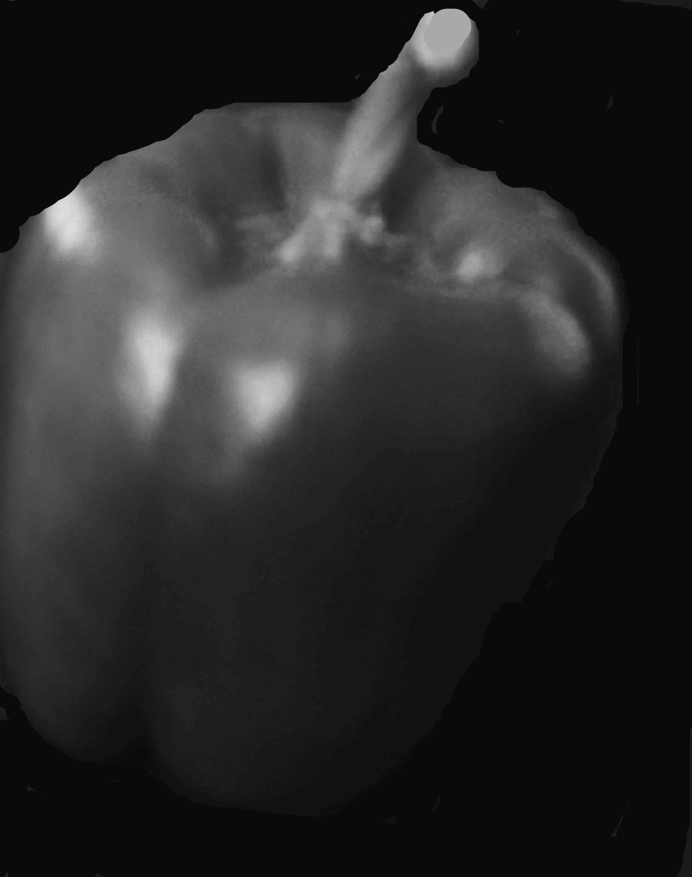
My Imitations

Slide 11
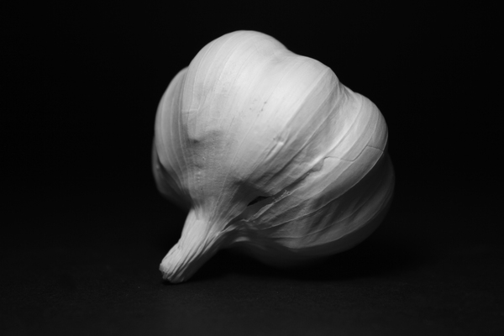
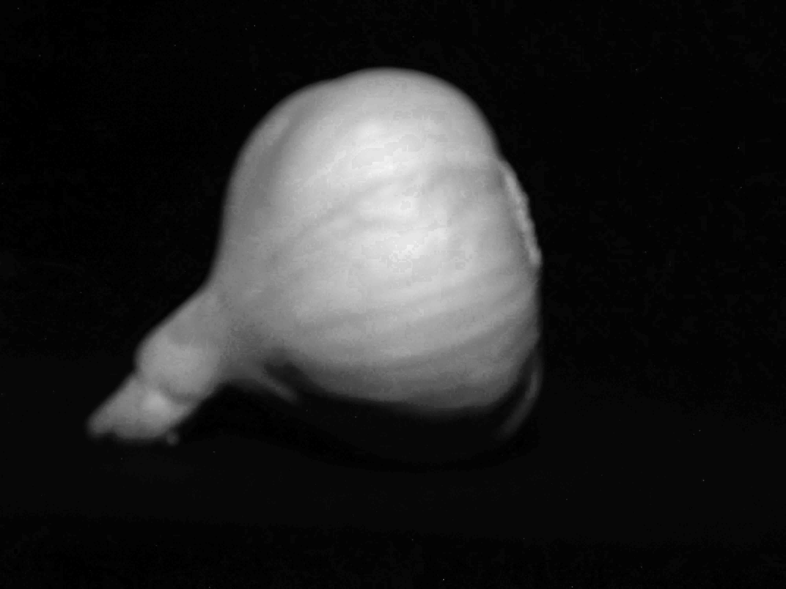
My Imitations

Slide 12
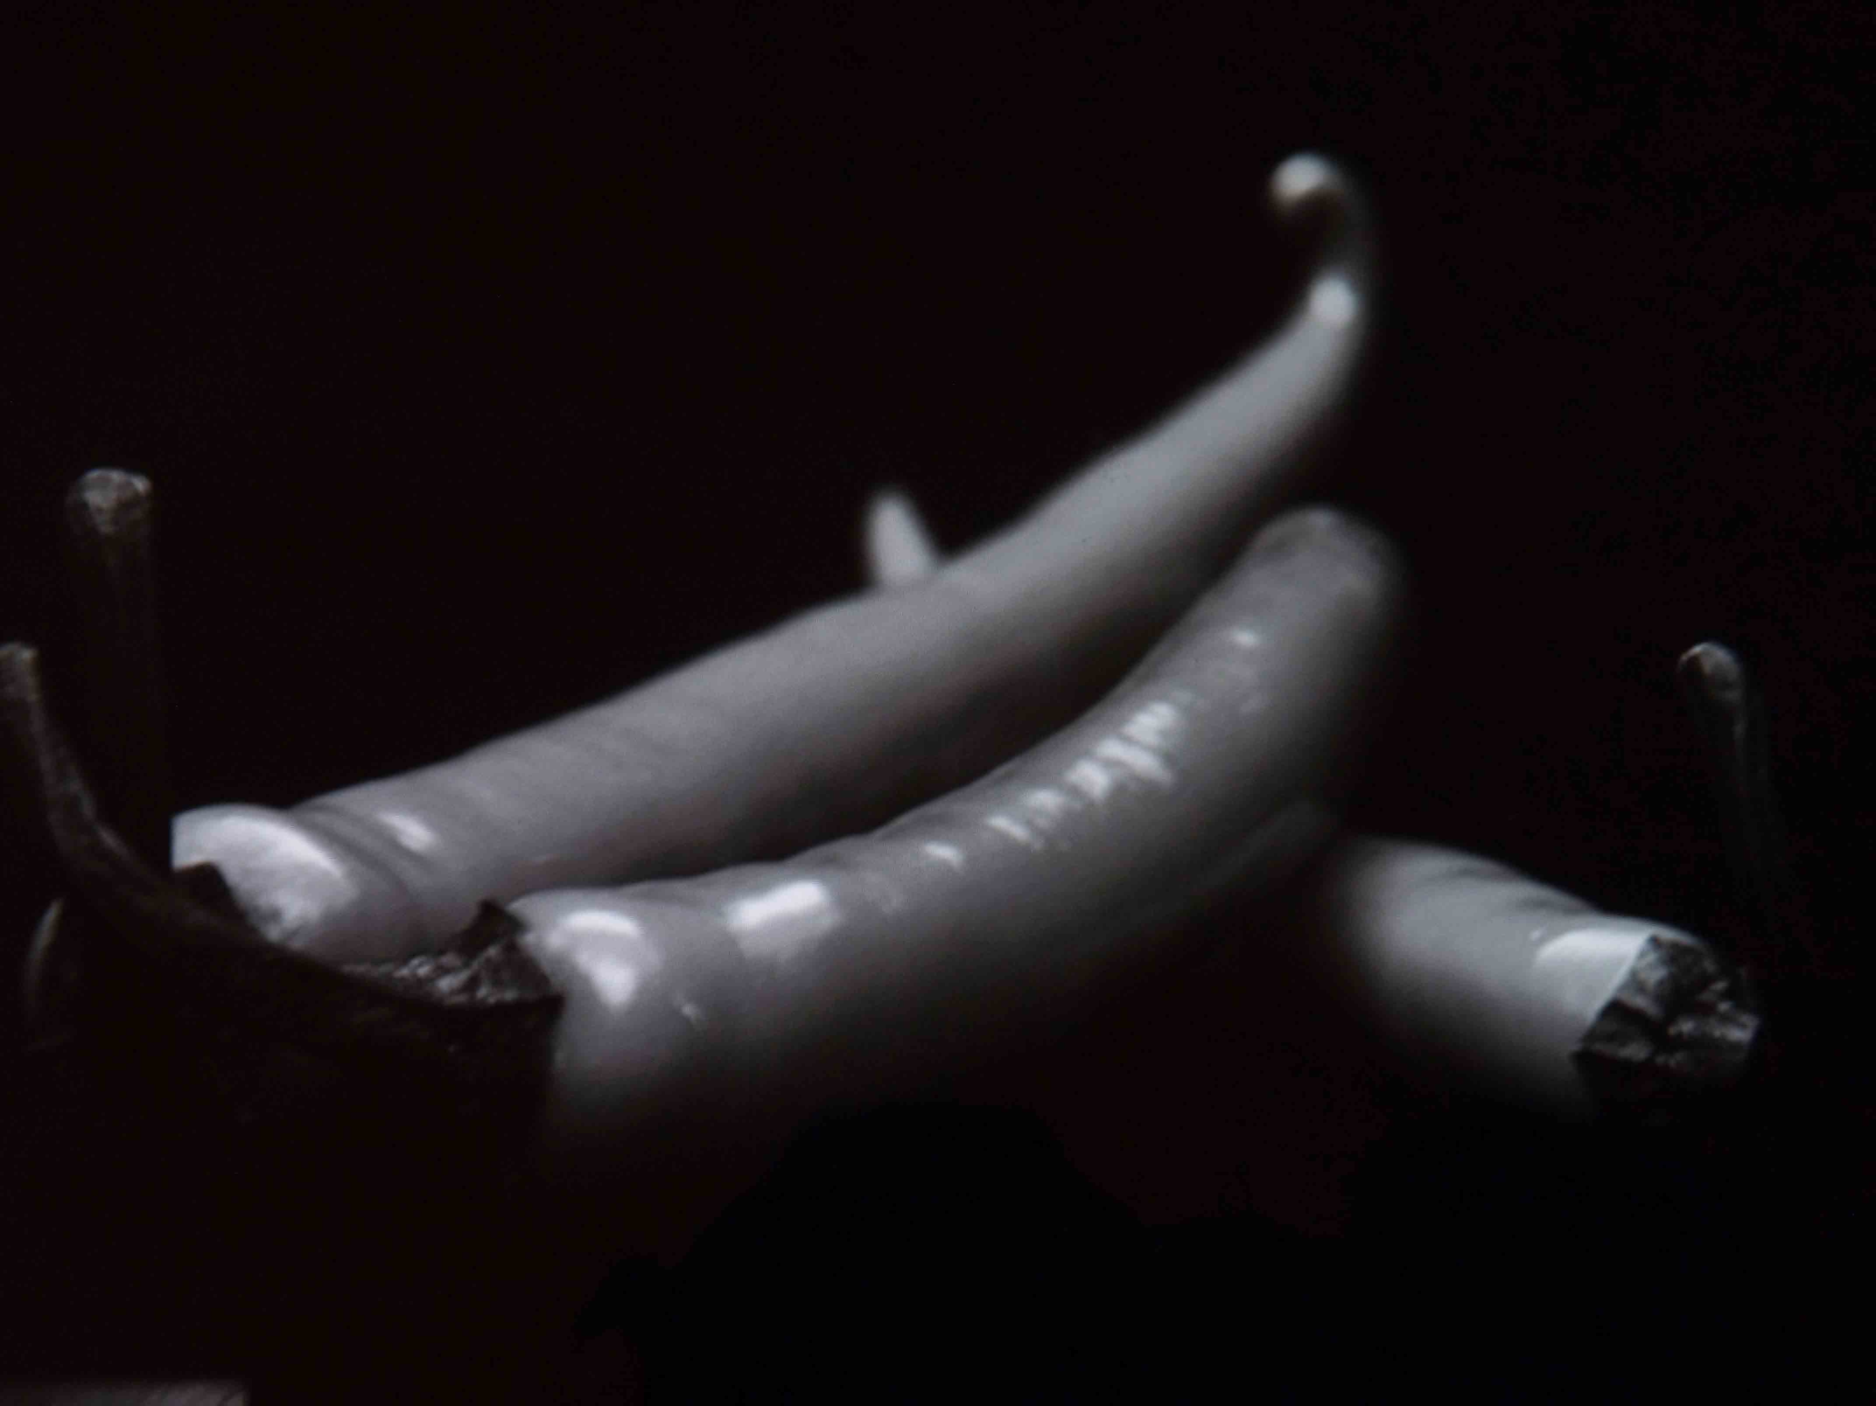
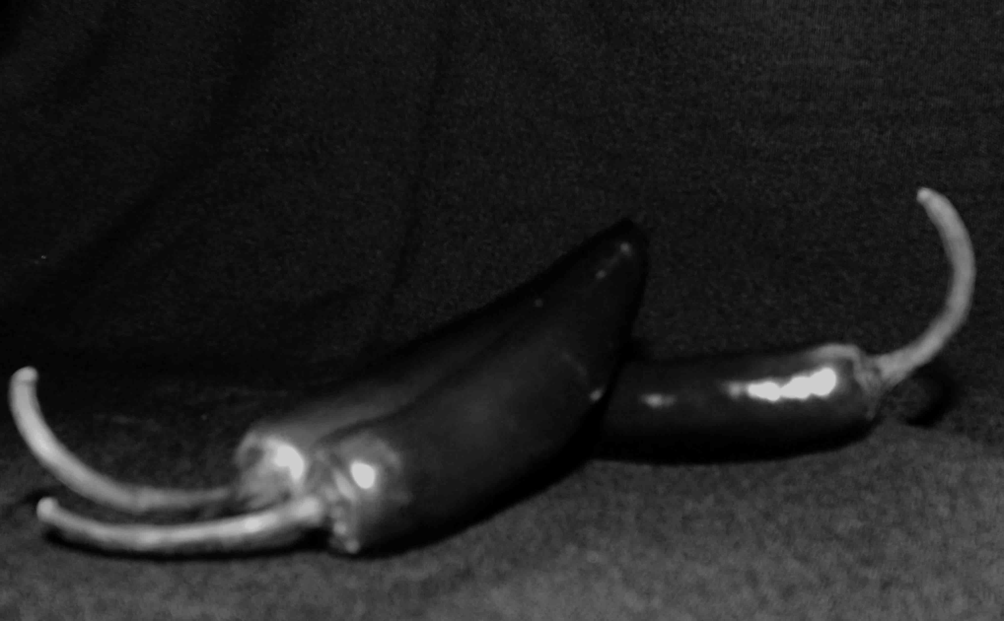
Imitation

Slide 13
Sources.
"Edward Weston." Photography : The 50 Most Influential Photographers of All Time. 1st Ed. ed. Hauppauge, NY :: Barron's, 2010, C2009. N. pg. Print.
Weston, Cole. "Edward Weston Bibliography." Edward Weston Bibliography. N.p., n.d. Web. 25 Feb. 2013. <http://www.edward-weston.com/edward_weston_biography.htm>.

